Slide 1
Machine Learning Solutions
for early sepsis detection

Slide 2
Machine Learning Solutions for early sepsis detection
1. Introduction |  | 6. Data processing pipeline and feature selection
2. What is sepsis and why would a ML solution be helpful |  | 7. Models
3. Objetive |  | 8. Monitization
4. Sepsis risk indicators
5. DataSet

Slide 3
1
Introduction

Slide 4
Machine Learning Solutions for early sepsis detection
1. Introduction
Sepsis is one of the leading causes of morbidity and mortality in hospitals.
The fundamental need for early detection and treatment remains unmet.
This resume is the first draft to outline how one could proceed in developing an MLA solution for questions like: early detections, survival or length of stay.

Slide 5
2
What is sepsis and why would a ML solution be helpful

Slide 6
Machine Learning Solutions for early sepsis detection
2. What is sepsis and why would a ML solution helpful
Sepsis is a major health crisis. It is one of the leading cause of hospital admissions and mortality world wide.
Play a role in 50% of hospital deaths.
270.00 fallacies each year US alone.
6 Millions world wide.
24 Billion each year in the US, 13% of hospital budgets.
4.2 million newborns and children are each year affected.

Slide 7
Machine Learning Solutions for early sepsis detection
Sepsis is a life threatening condition caused by your body’s response to an infection.
In cases of septic shock, the risk of dying increases by approximately 10% for every hour of delay in receiving antibiotics.
Early detection of sepsis events is essential improving sepsis management and mortality rates in the ICU.
Few electronically monitoring methods of patients provide predictive capabilities to enable early intervention.

Slide 8
3
Objetive

Slide 9
Machine Learning Solutions for early sepsis detection
3. Objetive
The goal of this work is the early detection of sepsis using physiological data. The early prediction of sepsis is potentially life-saving, and we aim to predict sepsis at least 6 hours before the clinical prediction of sepsis.
Q1: Early sepsis prediction
Q2: Predict patient admission
Q3: Predict severeness and survival
Q4: Predict hospital length of stay (LOS)

Slide 10
4
What are sepsis Indicator

Slide 11
Machine Learning Solutions for early sepsis detection
4. What are sepsis Indicator
Common scores are such as the Modified Early Warning Score (MEWS), the SIRS criteria and the Sequential Organ Failure Assessment (SOFA)
Sepsis: suspicion of infection with at least two SIRS criteria. SIRS criteria are defined as:
heart rate >90 beats per minute
body temperature >38°C or <36°C
respiratory rate >20 breaths/min or PaCO2 (alveolar
carbon dioxide tension) <32 mm Hg
white cell count >12 x 109 cells/L or <4 x 109 cells/L.10
Designed to predict patient risk, rather than specifically diagnose sepsis

Slide 12
5
DataSet

Slide 13
Machine Learning Solutions for early sepsis detection
5. DataSet
The date obtained is a 40.000 patient strong dataset which was made public for the 2019 Physionet Challenge
The data has 40 features which can broadly be classified into
8 Vitals Signs – Heart Rate, Temperature, MAP, …
28 Laboratory Values – FiO2, Lactate, Bilirubin, …
6 Demographics – Age, Gender, Hospital Unit, …
There are two ways in which one can approach this problem:
1. Temporal Approach: Take into the account the time component for the data. Sepsis is diagnosed for each patient at each hour using the past data.
2. Non-temporal Approach: Ignore the time component and treat record as independently and identically distributed. This approach would help in predicting Sepsis at each hour for any patient(with or without patient past data).

Slide 14
6
Data processing pipeline and feature selection

Slide 15
Machine Learning Solutions for early sepsis detection
6. Data processing pipeline and feature selection
We eliminate variables which have greater than 82% missing values, except Bilirubin direct, Lactate, Partial thromboplastin time (PTT), Creatinine, Leukocyte count (WBC) and Glucose which are known as significant variables for detecting sepsis.
Eliminate SBP and DBP, since MAP = (SBP + 2*DBP) / 3
For the vital sign’s variables, if a patient did not have a measurement in a given hour, the missing measurement was filled in using carry-forward imputation

Slide 16
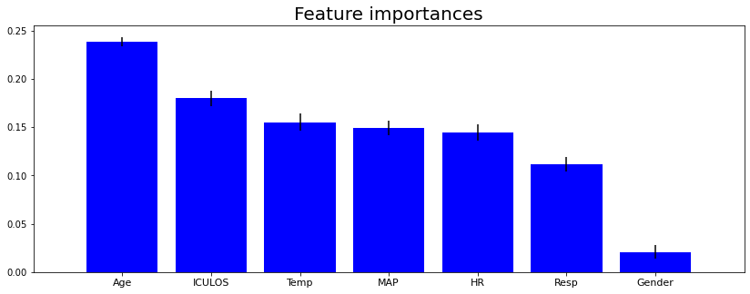
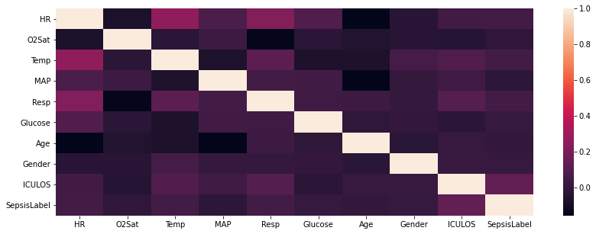
Machine Learning Solutions for early sepsis detection
6. Data processing pipeline and feature selection
Correlation heatmap of selected features:
Random Forest importance features computation:

Slide 17
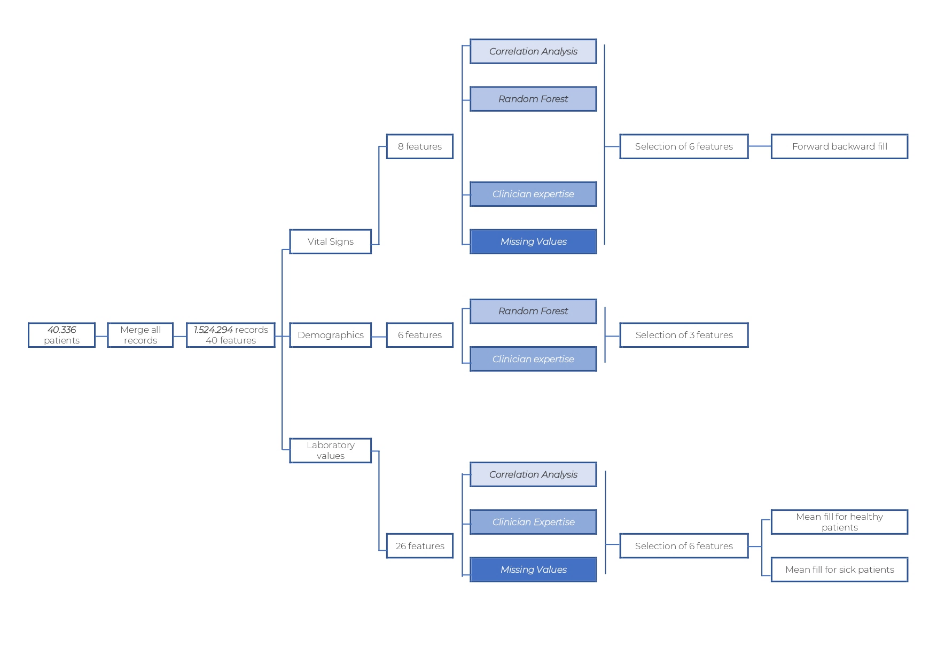
Machine Learning Solutions for early sepsis detection
6. Data processing pipeline and feature selection

Slide 18
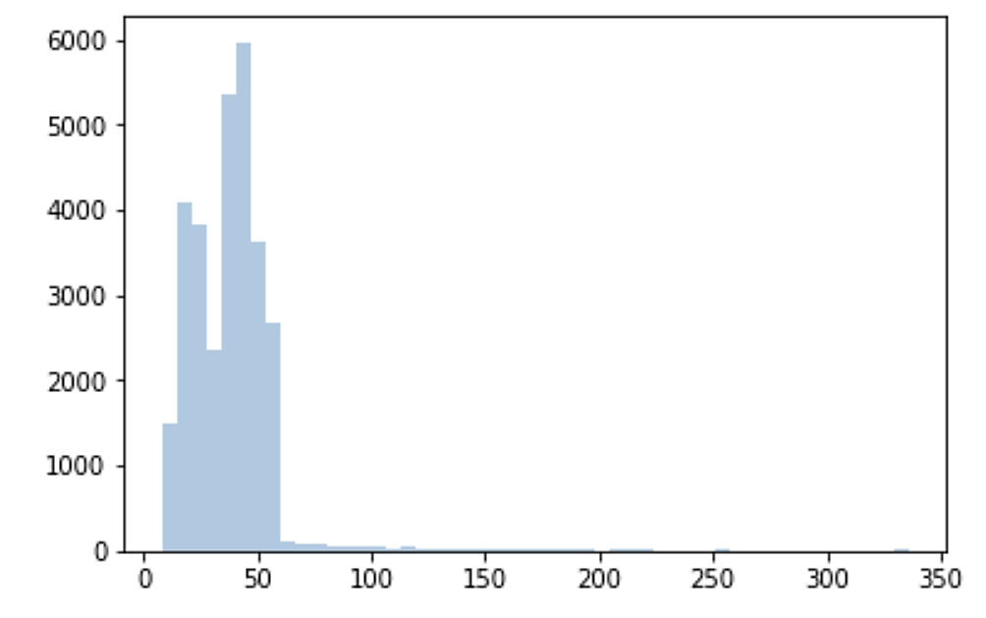
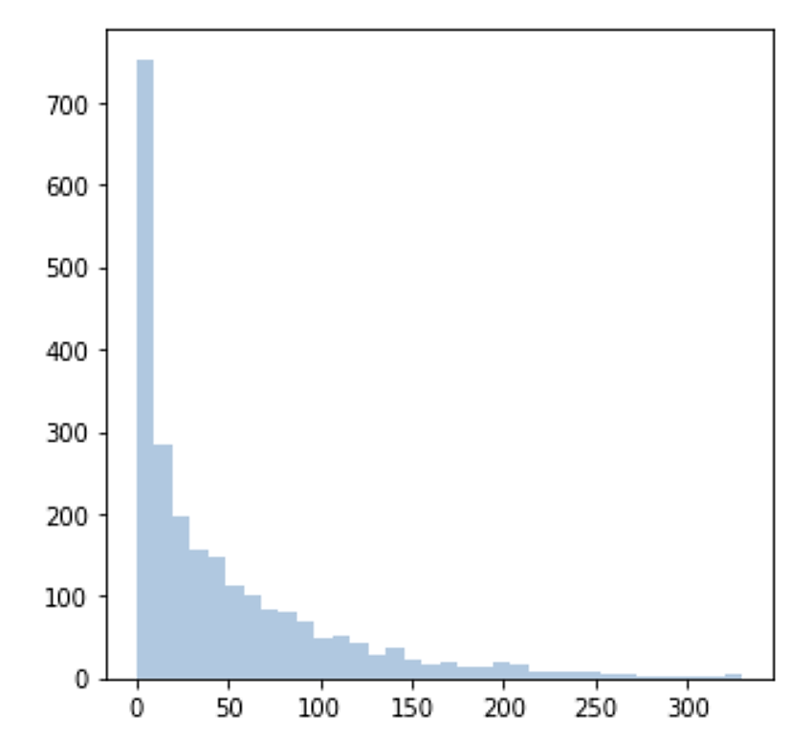
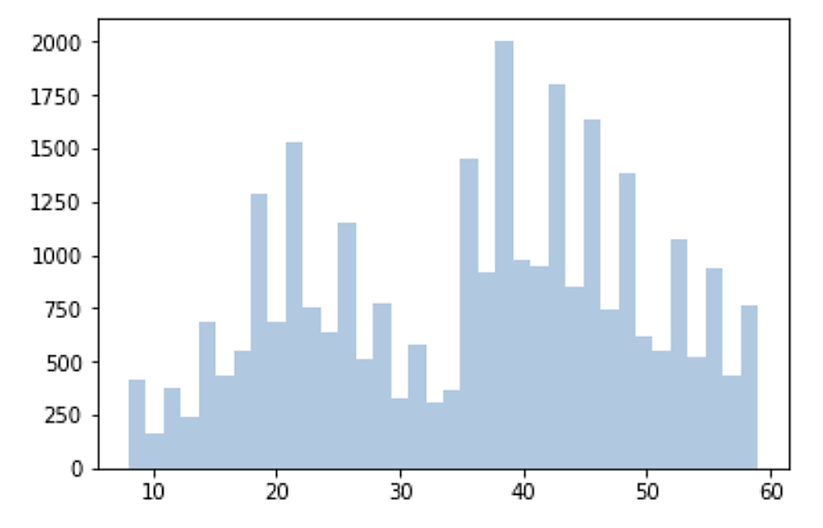
Machine Learning Solutions for early sepsis detection
6. Data processing pipeline and feature selection
Time at which a patient contracts Sepsis:
Number of hours a patient spends in Hospital

Slide 19
7
Models

Slide 20
Machine Learning Solutions for early sepsis detection
7. Models
To get an Baseline one can quickly run a mix of standard ML algorithms to get familiarized the the dataset and its limits, such as
Logistic Regression
AdaBoost
Gradient Boosting
Random Forest
Autoencoders / anomalies detection
DNN or GXBOOST

Slide 21
Machine Learning Solutions for early sepsis detection
7. Models
SIGNATURE APROCHE
Hand-Crafted features
ShockIndex : Heart Rate / Systolic Blood Pressure
BUN/CR: Bilirubin / Creatinine
PartialSOFA Score of the SOFA components that are found in the challenge data
Signature Features
The signatures of ‘PartialSOFA, ‘MAP’ and ‘BUN/CR’ are computed with a time dimension and the lead-lag transformation and then signatures of all non-stationary columns are computed after first applying the cumulative sum followed by the lead-lag transformation.
Train an LSTM and use the output as a feature in the LGBM Regressor with a stratiified 5-fold croos validation method.

Slide 22
8
Monitization

Slide 23
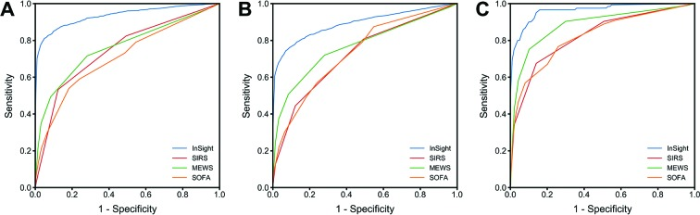
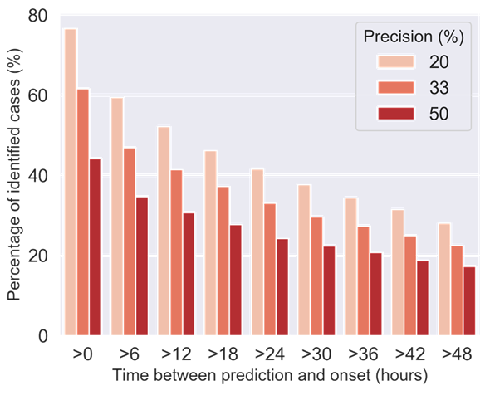
Machine Learning Solutions for early sepsis detection
8. Monitization
An market ready MLA can be integrated with all major EHR systems.
Gold standards test SOFA, SIRS, SEWS and InSight with AUROC curve of 0.725, 0.609, 0.803 and over 0.90, respectively.
The Signature model often detects sepsis much further in advance, regularly over 24 hours

Slide 24
Jonas Grabbe
grabbe.jonas@gmail.com
+34 688 90 89 62

